Slide 1


Fault injections on SYSTOLIC ARRAYS
STUDENT: ADAM GHADBAN
SEMESTER: 2023 SPRING

Slide 2
INTRODUCTION
ASICS are used more and more in the industry of ML:
Autonomous cars.
Space related applications.
Smart phones.
VLSI technology scales down, making transistors more prone to fault errors.
Radiation, adversarial attacks, timing, glitching, transistor aging etc...

Slide 3
Fault injections
Fault injection is the process of inducing a fault in hardware.
There are two main types of fault injections:
Transient fault: a temporary fault.
Permanent fault.
Bit-flips, stuck-at, bit set/reset, random-byte, etc... .
Fault injection methods:
Voltage/clock glitching: setup and hold constraints.
RowHammer attacks: intensive reads from DRAM.
Optical faults: e.g., laser attacks.
Electromagnetic waves: bit flips.

Slide 4
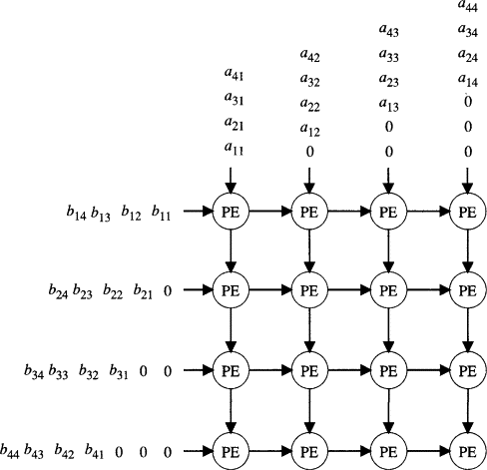
SYSTOLIC ARRAYS
ASIC accelerator for matrix multiplication.
Clocked, pipelined and very fast.
Implemented in VHDL, usually synthesized on FPGA’s for speed.
Google’s TPU’s building block is a systolic array.
Hardware, thus prone to fault injection attacks.
Systolic arrays include:
Clocks.
MAC IP’s.
Memory for weights, biases and the input matrix.

Slide 5
Faults in systolic arrays
The authors of the article have defined a FuSa (Functional Safety) assessment method, which states that a fault is considered to induce a FuSa violation iff it impacts the correctness of the prediction.
Per the authors’ definition, a transient fault is a fault that affects a single layer, where a permanent fault affects all the layers.

Slide 6
Fault model in article
Used an MLP.
Faults in a random MAC register, between bits 14 and MSB.
Faults in multiple MAC registers, only on MSB.
Faults on a random MAC register and use different activation functions.
Number of layers and its correlation to error propagation.
Layer width and its correlation to error propagation.
Data-set and its correlation to fault tolerance

Slide 7
Suggested changes
Use ResNet18 instead of MLP, as its better for image classification.
Check error propagation in CNN’s.
Improve fault model to be more life-like*:
Inject faults in input matrix (adversarial attacks ☺).
Use a less strict fault model by injecting multiple adjacent faults into an element.
Introduce faults to weights and biases.
* Faults in real-life (low budget and typical natural faults, like EM) usually affect more than one bit.

Slide 8
Project flow
Take a trained model (ResNet or CNN) on a CIFAR10 set in python.
Inject faults into weights, biases and memory. Note that we suppose that each fault injected into these matrices can be translated into one or more faults in a MAC register in a systolic array.
Emulation of faults on the network. Fault model will be discussed in next slide.

Slide 9
Fault injector methodology
Must be versatile.
Must be generic and not architecture specific.
Must be able to inject a wide range of faults into the network.
Must be fast.
Must have a human readable way to dump data.

Slide 10
Fault injector
CLI based.
Networks are mainly RobustBench’s networks.
Training dataset is CIFAR-10.
Can parse network layers dynamically, with dumping what each layer has for matrices (bias and weight).
Can choose a layer, a fault target (memory, bias or weights), choose bits to flip (or randomly chosen per a distribution), choose distribution of faults.

Slide 11
Faul models discussed
Bit flip location across fault (bit granularity).
Number of faults across a matrix.
Fault distribution across matrix.
Layers across the network, mainly to check the most critical place.
Distribution of bit-flips across a target.

Slide 12
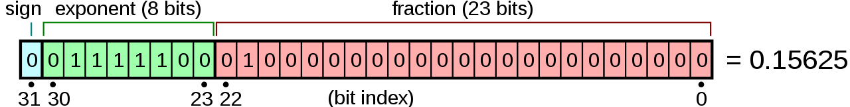
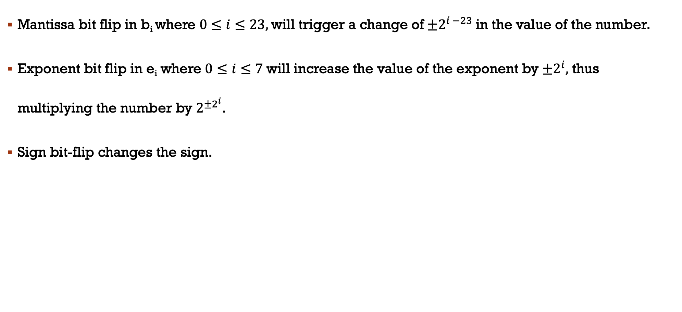
float32
Mantissa bit flip in b_{i} where $0≤i≤23,$will trigger a change of ${±2}^{i −23}$in the value of the number.
Exponent bit flip in e_{i} where $0≤i≤7$ will increase the value of the exponent by ${±2}^{i},$ thus multiplying the number by $2^{{±2}^{i}}$.
Sign bit-flip changes the sign.

Slide 13
Bit granularity
The network was trained and was used in inference in float32.
Check the effect of lower, middle and higher mantissa bit flips in a target.
Check the effect of lower, middle and higher exponent bits.
Check the effect of sign bit.

Slide 14
Fault related metrics
Find the relation between number of faults and the network FuSa violations.
Find the relation of the fault distribution across the target (Gaussian vs Uniform) on FuSa violations.
Find the relation of “how much deep” is the layer and FuSa violations.
Distribution of bit-flips across target and its relation of FuSa violations.
Bias vs memory vs weight.

Slide 15
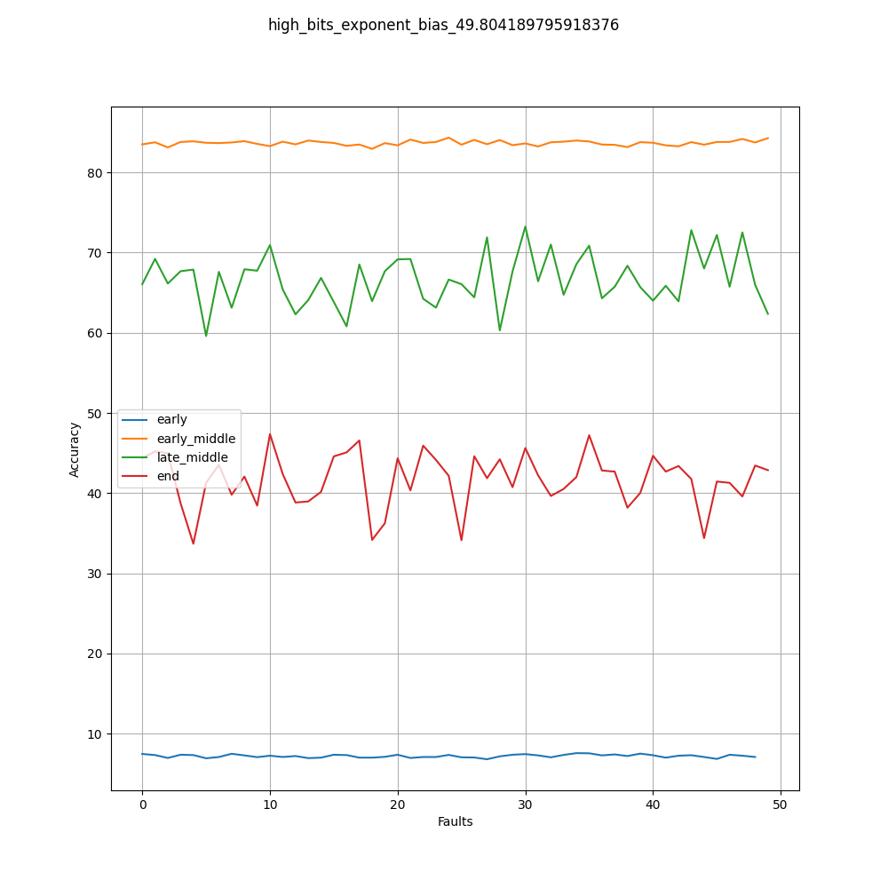
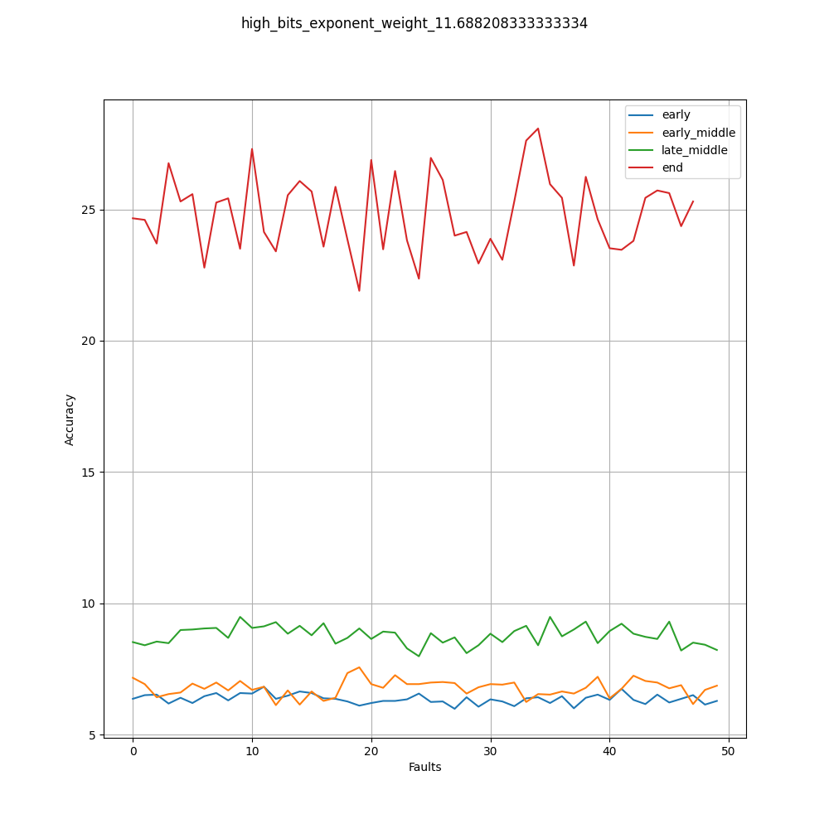
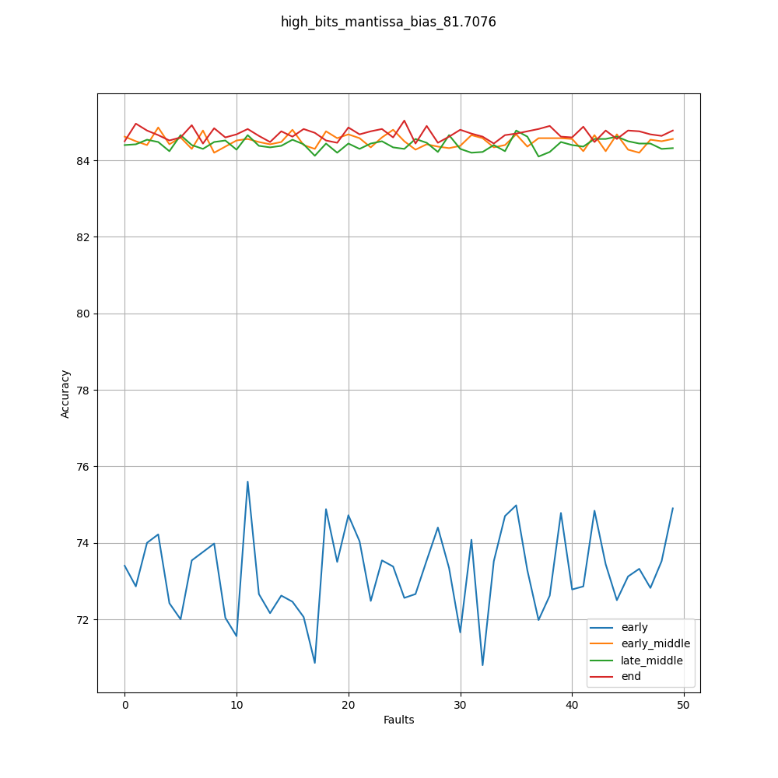
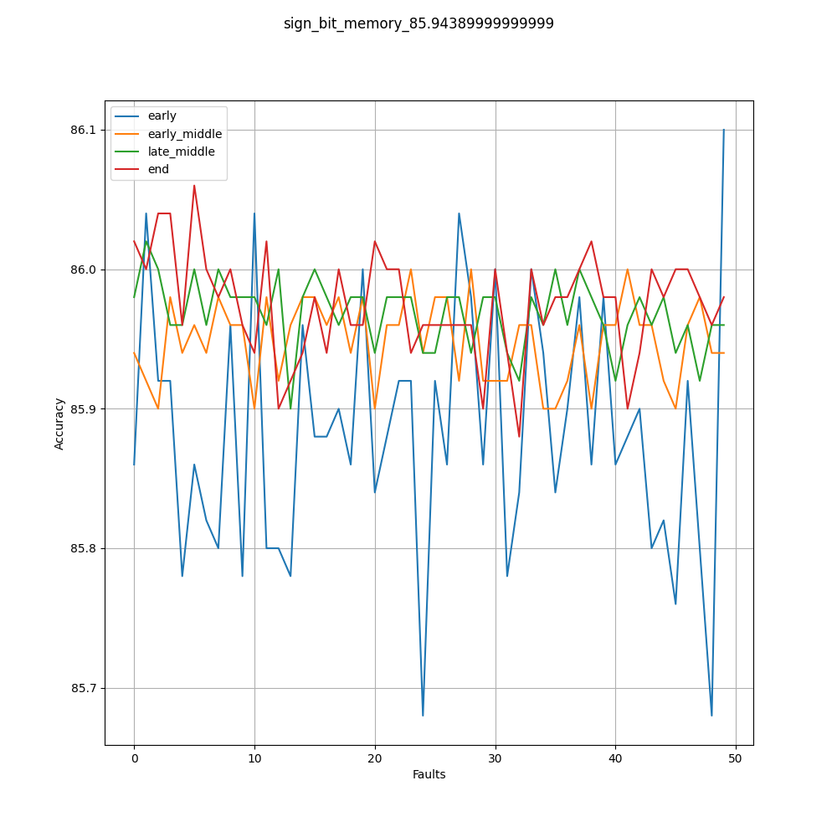
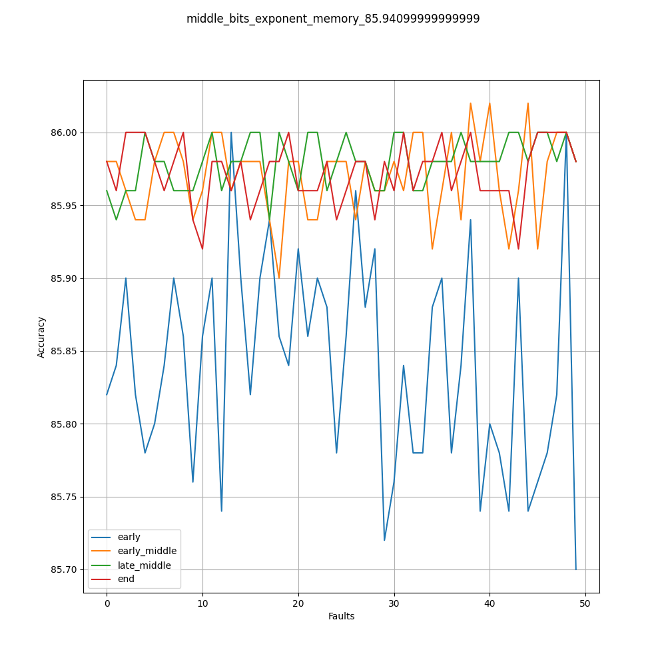
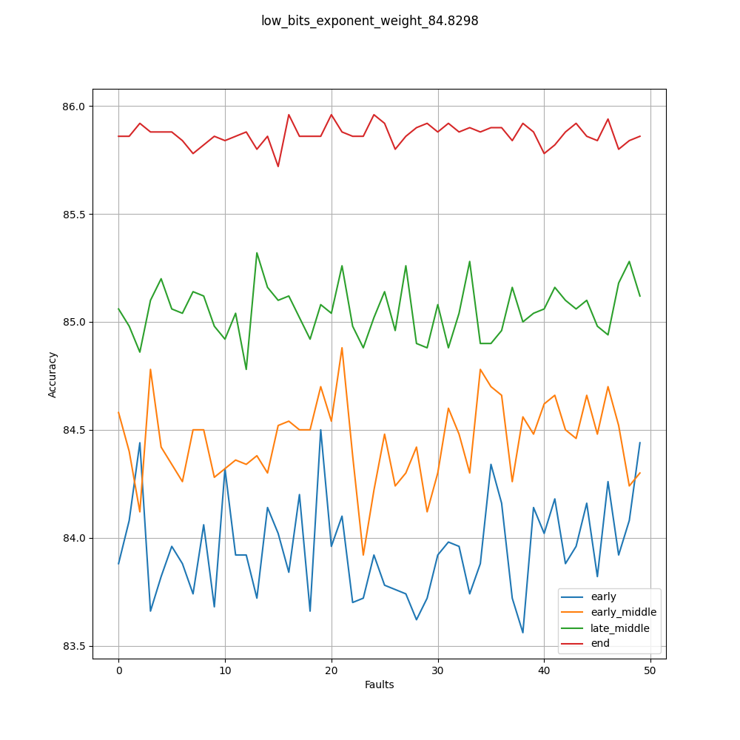
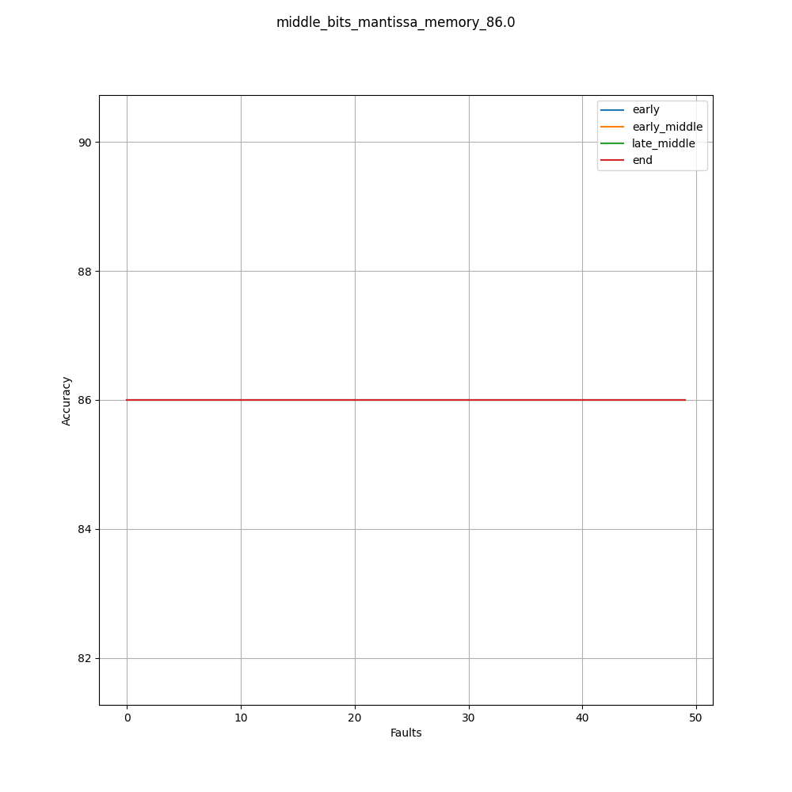
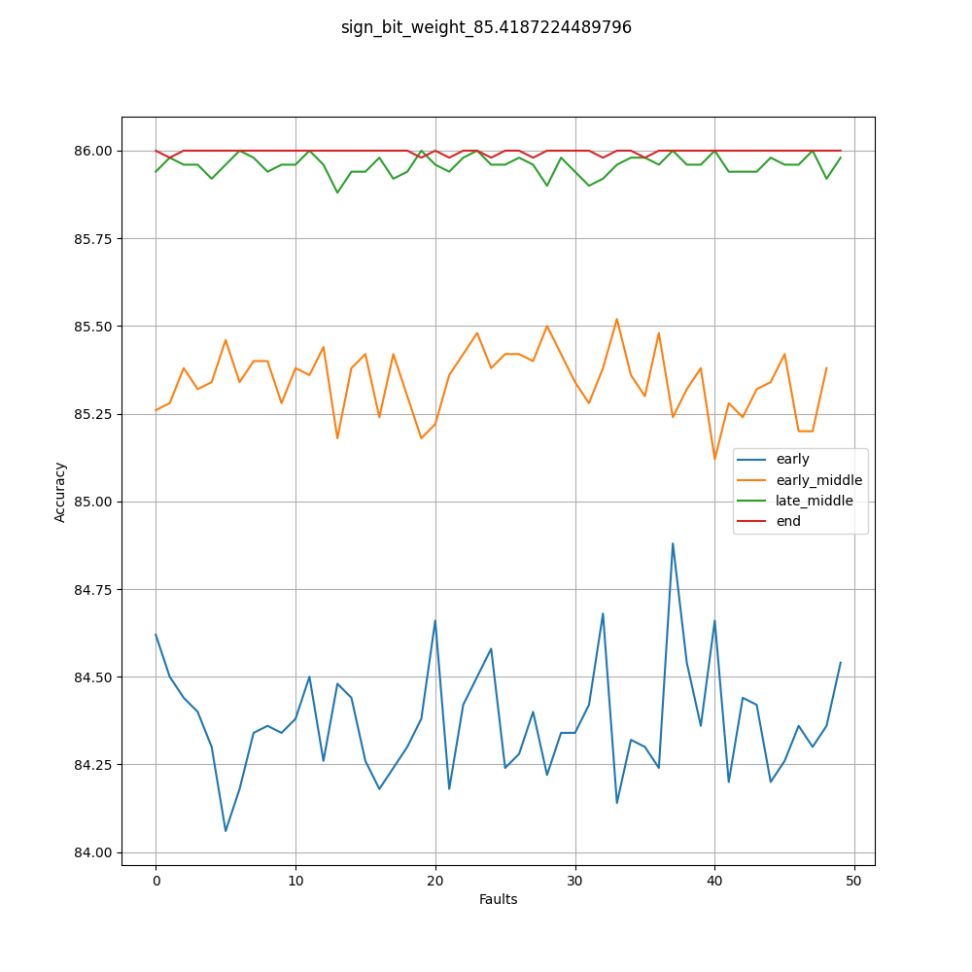
Results
Mantissa bit flips are dangerous when flipping higher mantissa bits.
Exponent bit flips are always dangerous, especially higher bit-flips. (drastically).
Sign bit is dangerous, not as much.

Slide 16
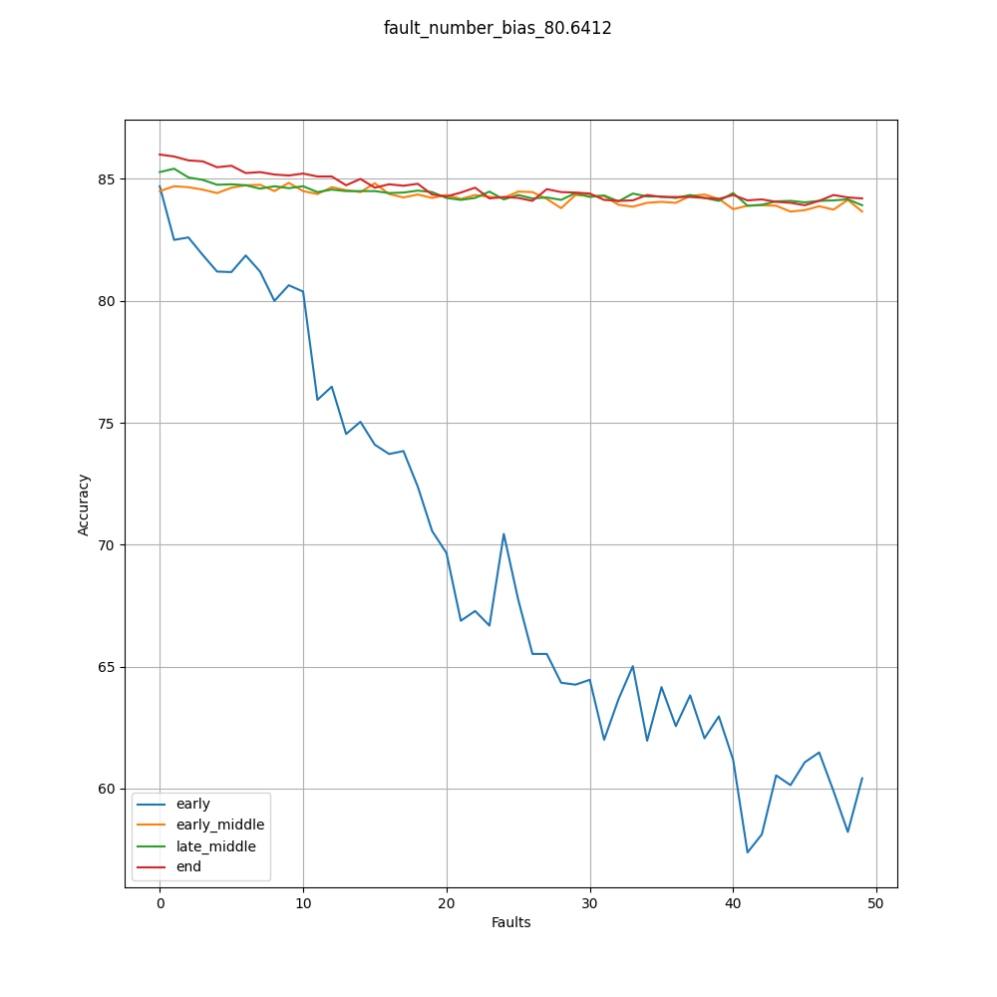
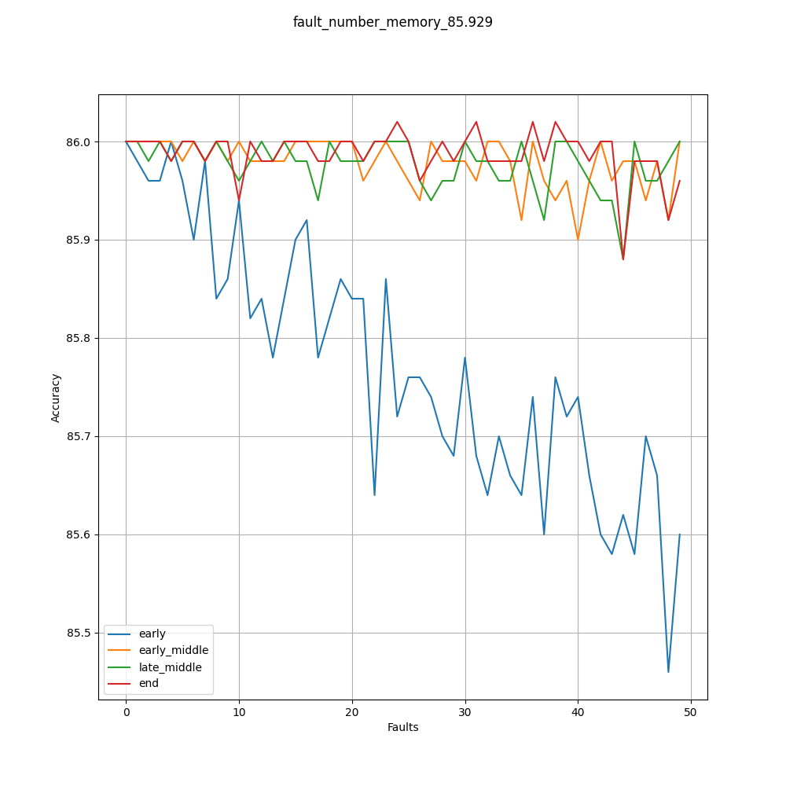
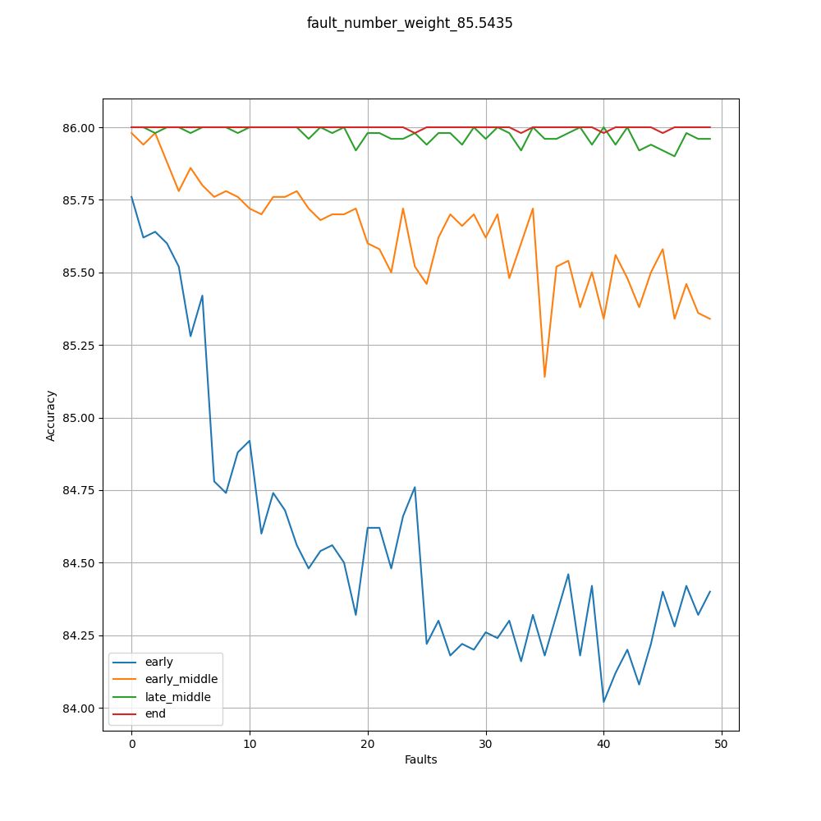
Results
Number of faults result was intuitive, the more faults, the more FuSa violations.

Slide 17
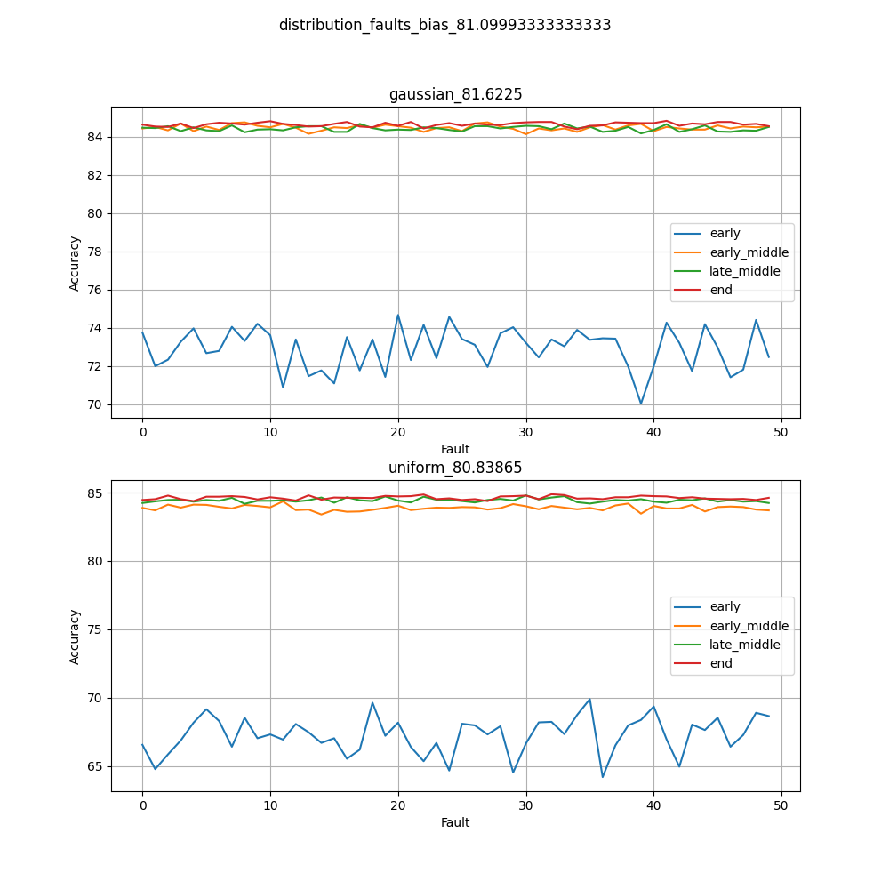
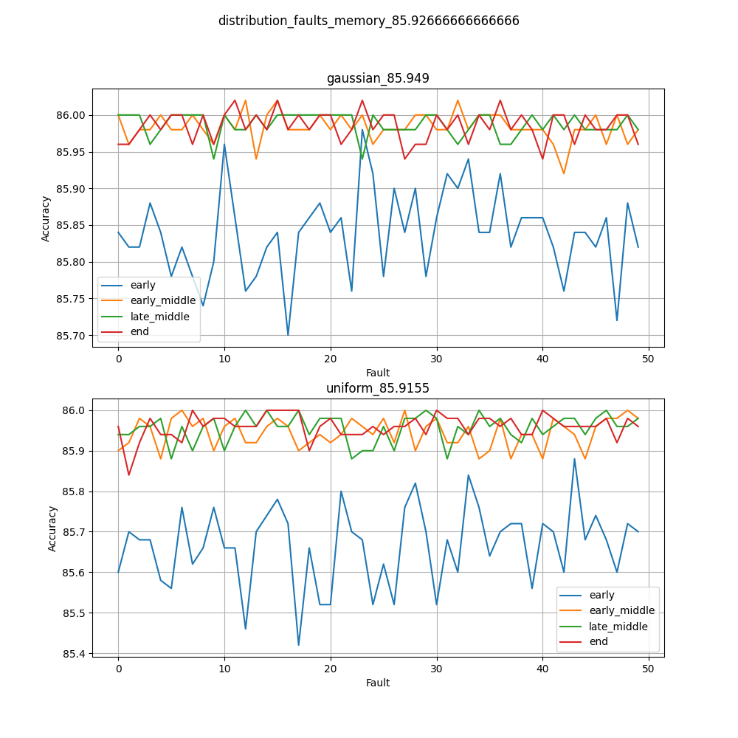
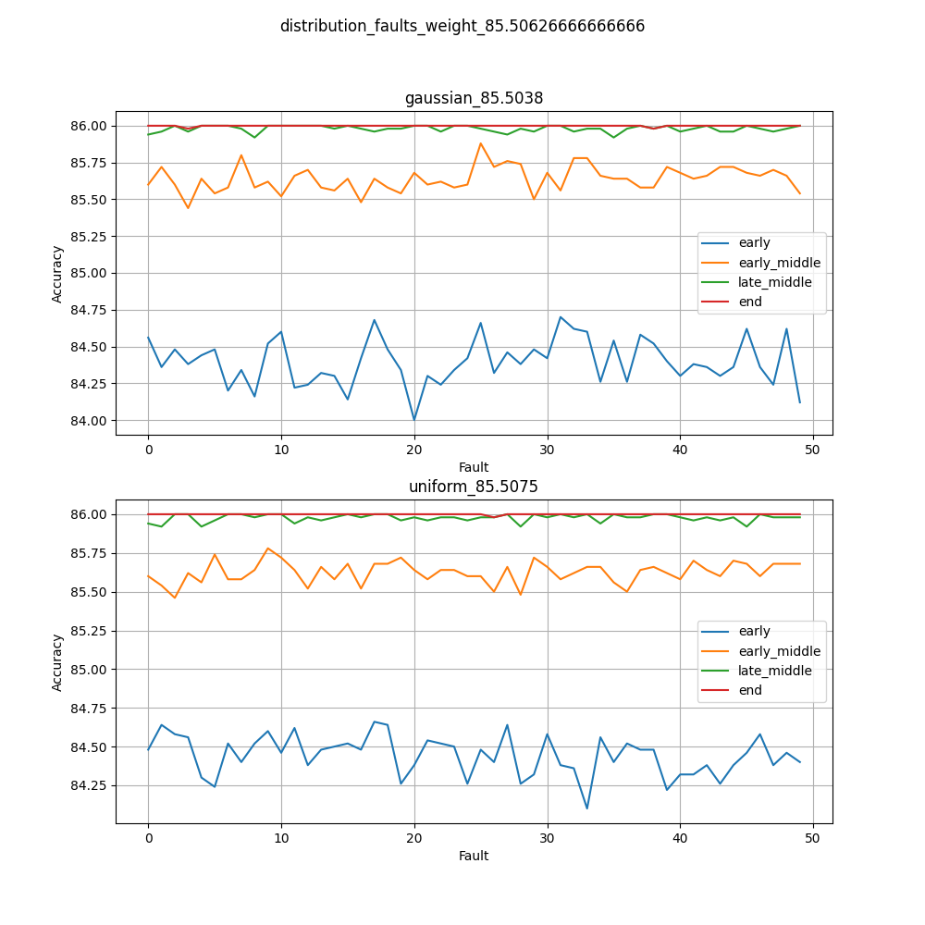
Results
Distribution of faults: Gaussian resulted in less FuSa violations in average.
Can be attributed to less neurons affected.

Slide 18
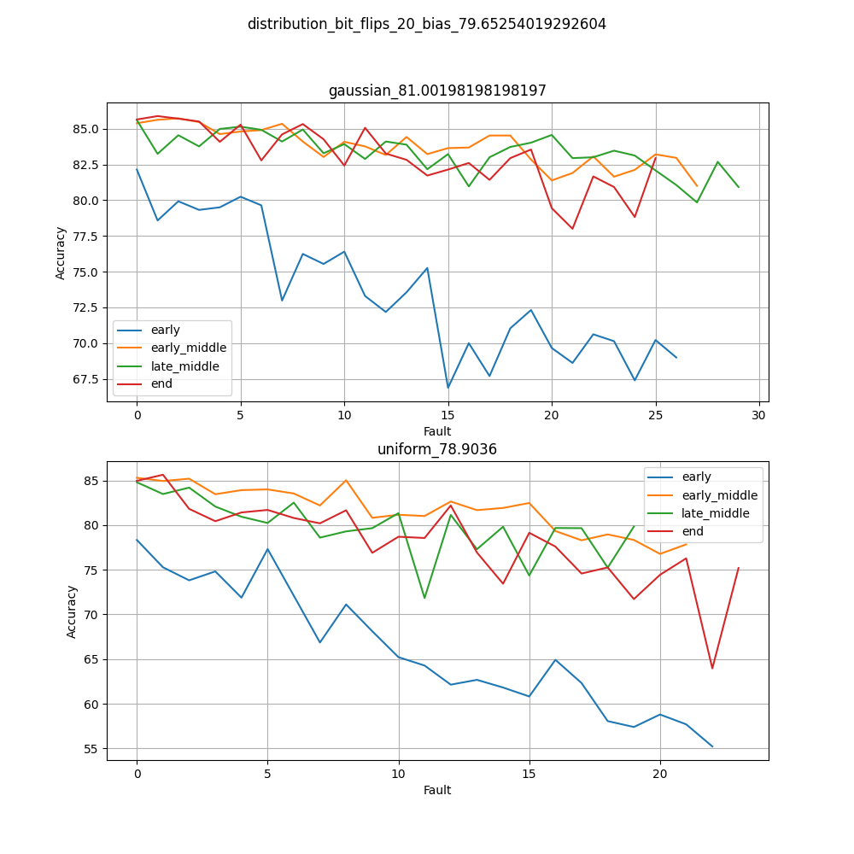
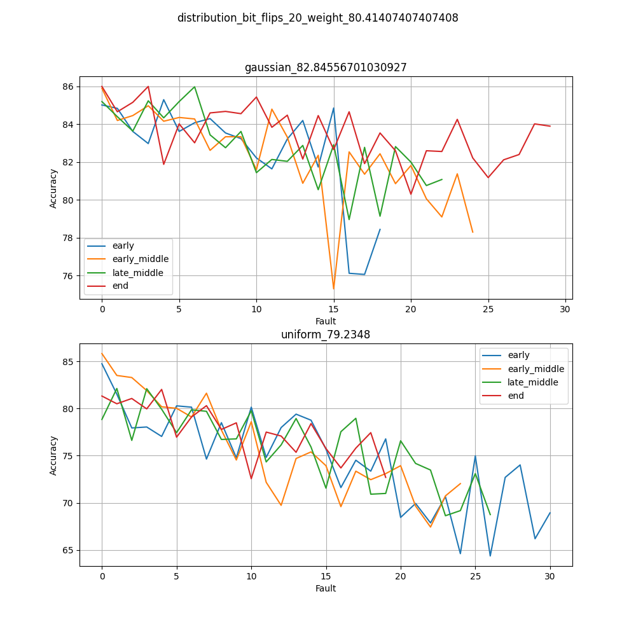
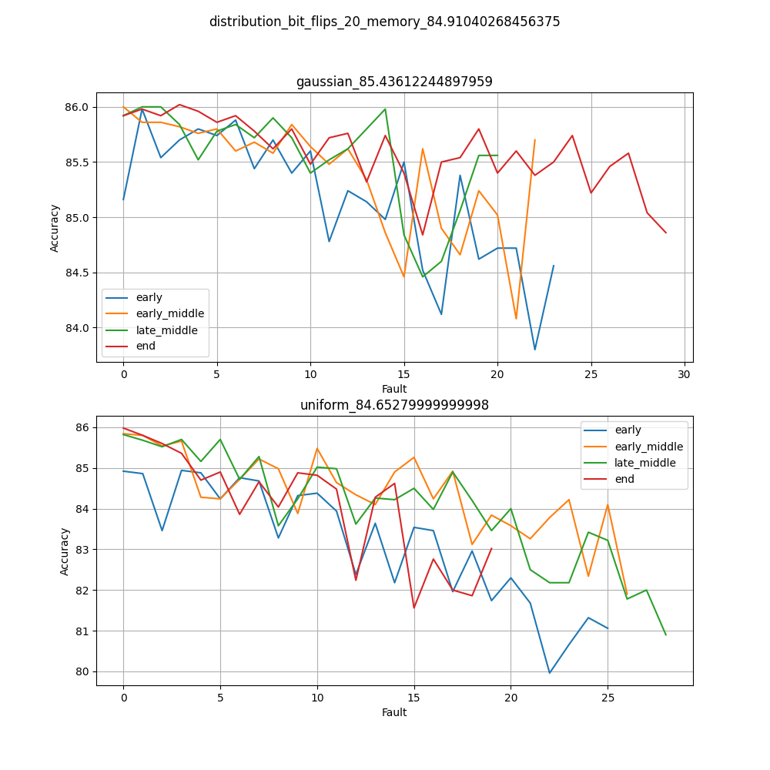
Results
Distribution of bit flips: depends on the Gaussian mean*. Low mean => Uniform with less FuSa violations. High mean => Gaussian can be worse.
*Mean around mantissa/exponent.
* Graphs here depict mean around 16th bit => Mantissa.

Slide 19
Interesting findings
The less deep the target layer is, the more it influences FuSa violations (simple feature extraction).
Bias is a more global value, and general activation functions (like ReLU) are very sensitive to bias faults => bias is usually a good target to induce FuSa violations in network.
DNN’s are robust, thus memory perturbations are usually masked out.
Strong weight faults in the last layers is worse than bias and first layers due to pattern extraction failure.

Slide 20
Implemented article:
Toward Functional Safety of Systolic Array-Based Deep Learning Hardware Accelerators – Kundu, Shamik; Banerjee, Suvadeep; Raha, Arnab; Natarajan, Suriyaprakash; Basu, Kanad
The end ☺
EMAIL: ghadbanadam@campus.technion.ac.il

